Slide 1
Quad Squad Property Management
Mansi Agarwal - Divya Bandapalle - Marion Cundari - Varad Shah
Notes:
Intro: Marion

Slide 2
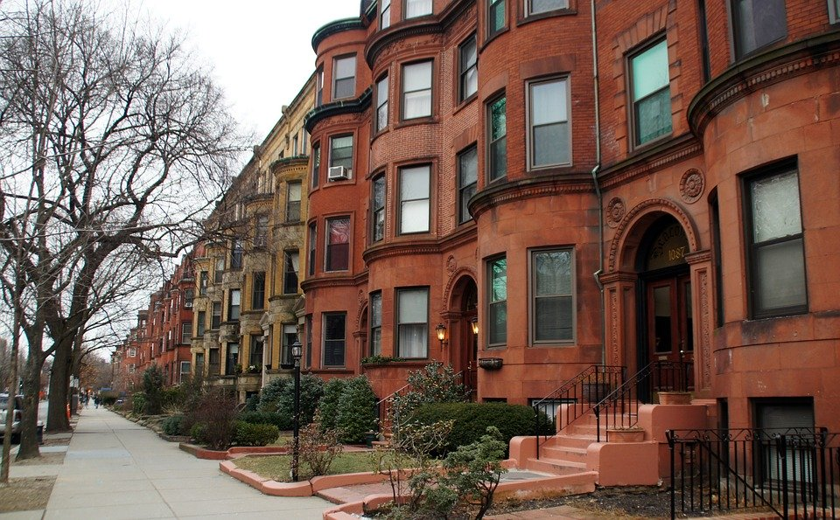
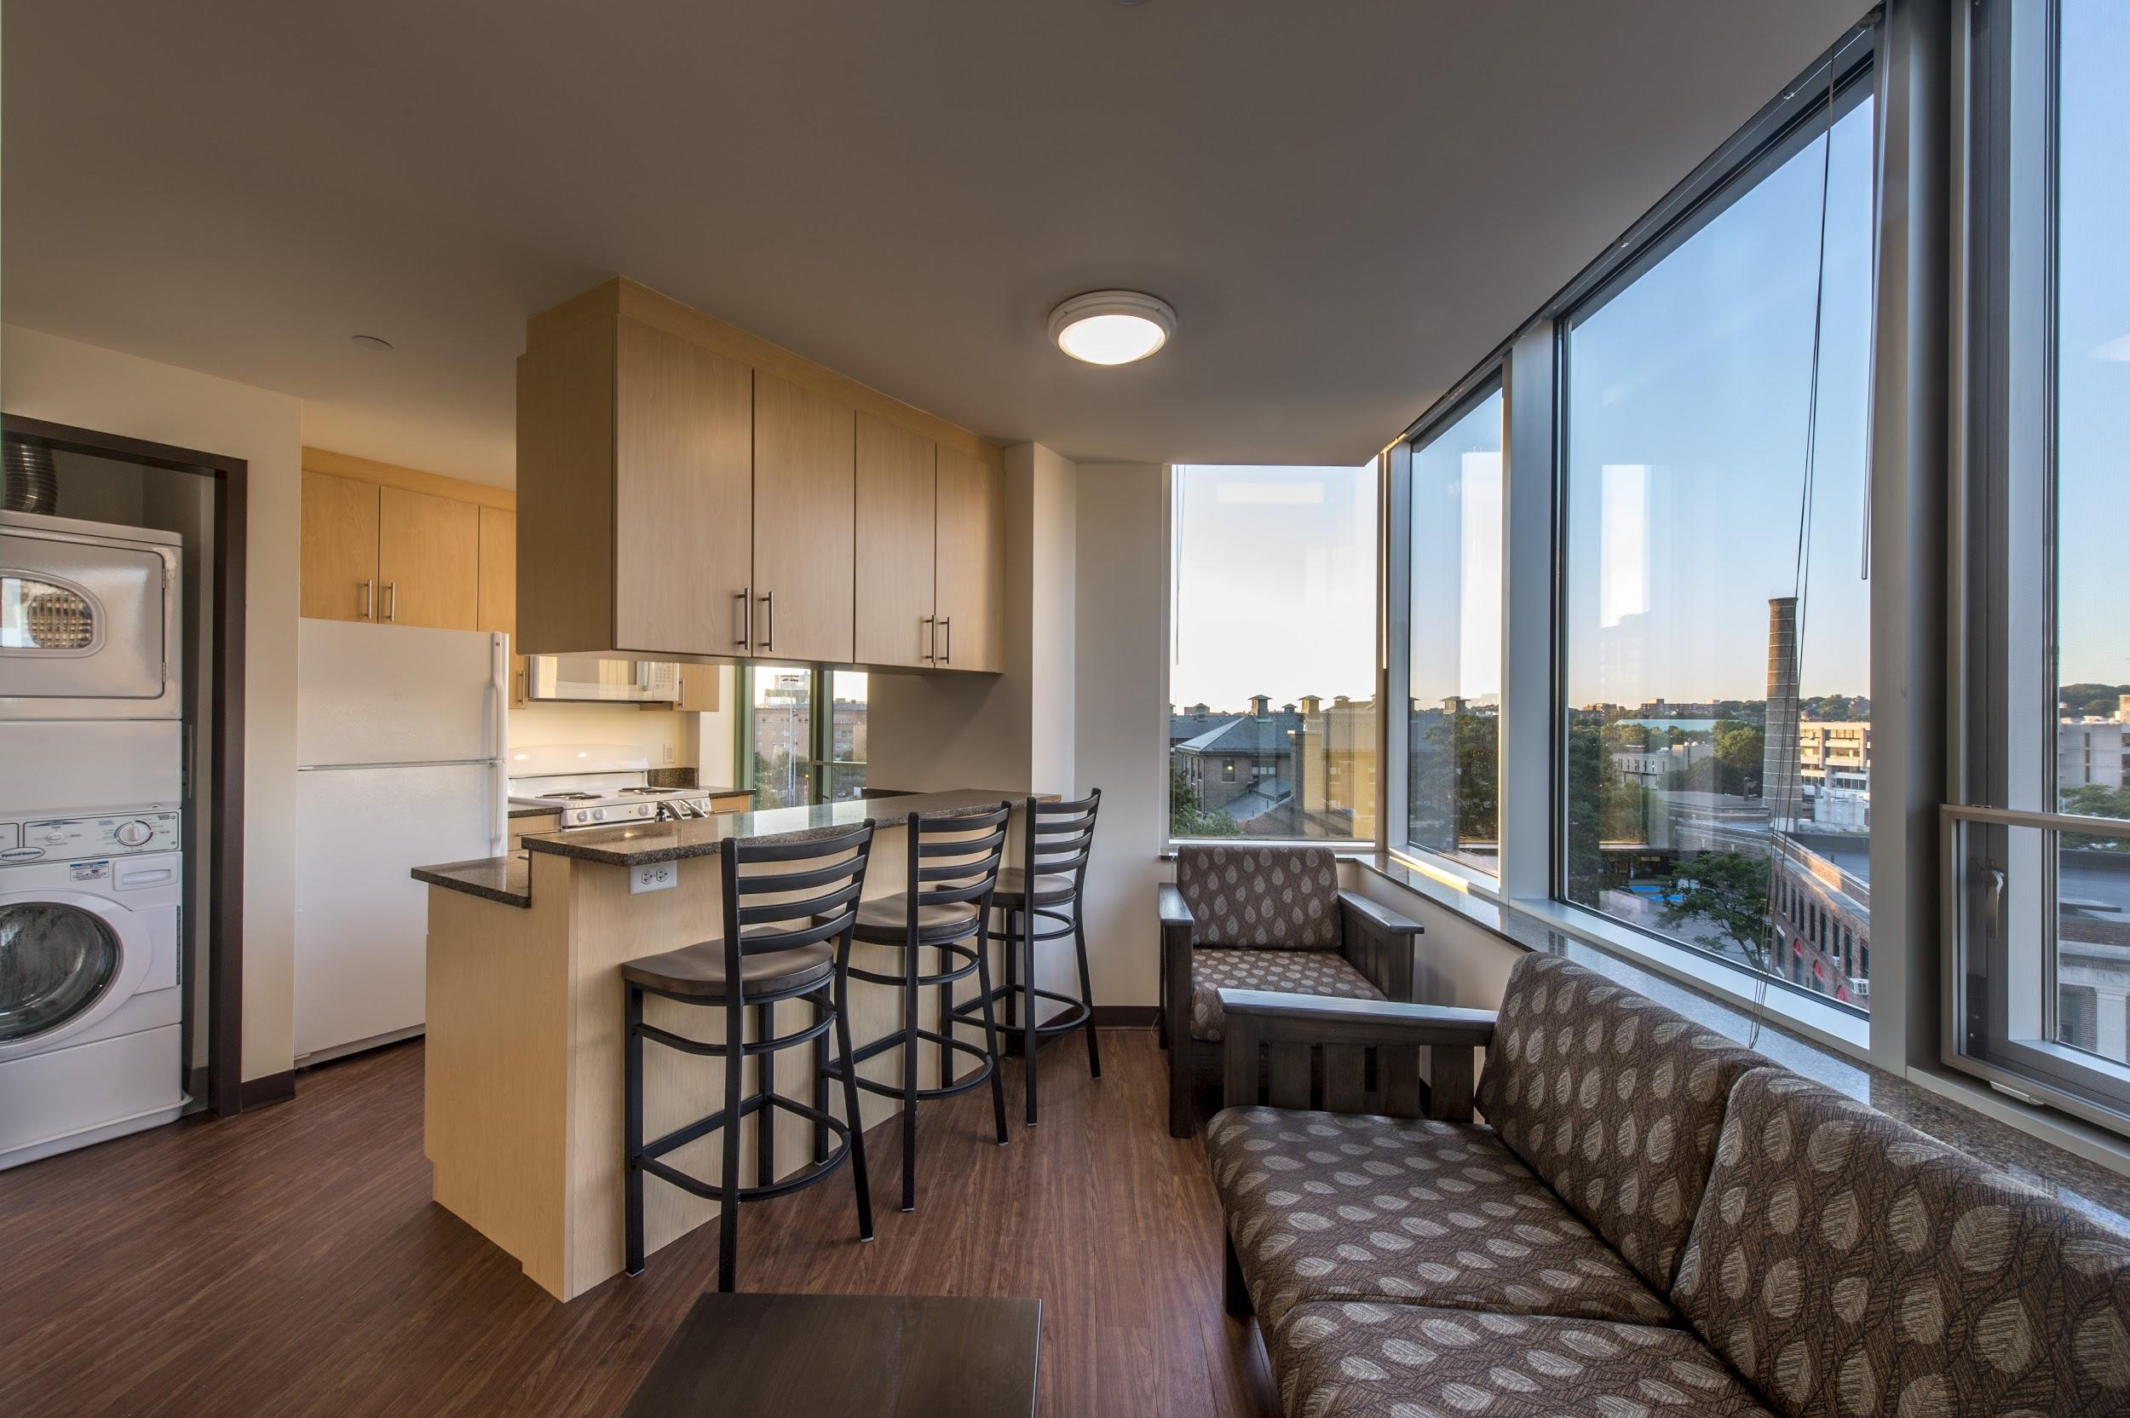
Why use a Database for a Property Management Co?
Mission: Streamline management functions via proper database implementation
Key Objectives:
Maintain record of units (characteristics and lease status)
Accept and track maintenance requests (completed or scheduled)
Monitor cash flow
Customer records (current and potential)
Track employee demographics
Broker details (if applicable)
Record of lease terms and applications
Notes:
Marion
Property management companies typically manage a large portfolio of rental units.
With even just one rental unit there is a laundry list of data that must be tracked.
So with a large portfolio reaching into the hundreds of units, a well maintained database to track crucial data is paramount to accomplish the Mission of streamlining management.
We designed our specific database to better enable the management company to track the key objectives listed here:
I won’t dive into these verbatim in the interest of time.
Pass to Divya for ERD
Status of a renta unit - is a unit vacant or leased?
Characteristics of each unit - how many bedrooms, how many bathrooms, is laundry in unit?
Maintenance requests submitted by customers or scheduled routinely
Rent payments - who paid, how much and when
Current and potential customers - age, salary, id
Employee characteristics such as type of employee (maintenance or management), hire date and skill set
Landlord owns unit
Customers submit applications for units, the management company must process these and either approve
If a lease is signed, the terms of the lease are tracked by the management company. Data such as lease start and end date.
Pass to Divya for ERD overview

Slide 3
Final Entity-Relation Diagram
Notes:
Divya

Slide 4
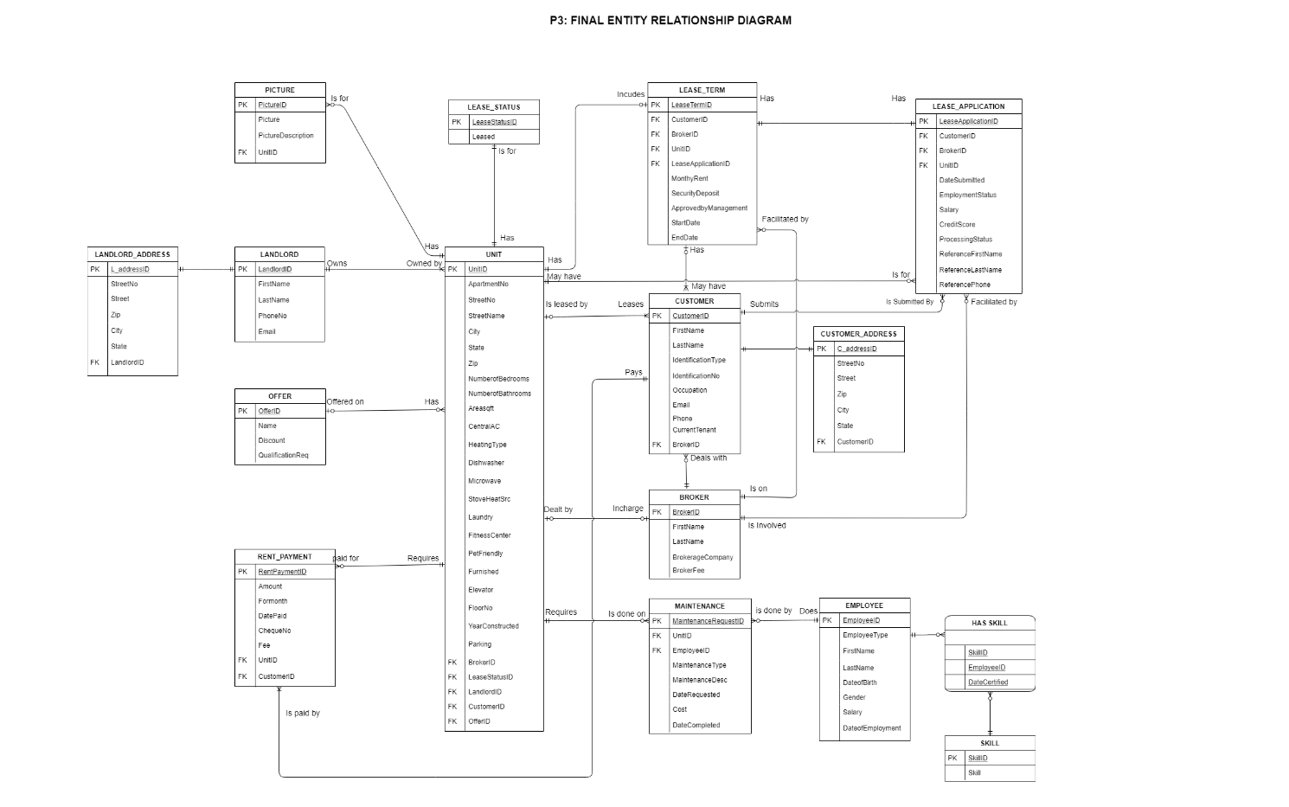
Notes:
Marion

Slide 5
SQL DDL
Notes:
Divya

Slide 6
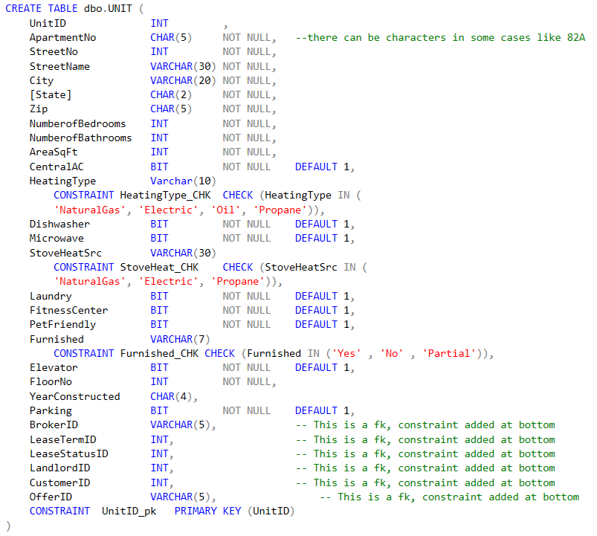
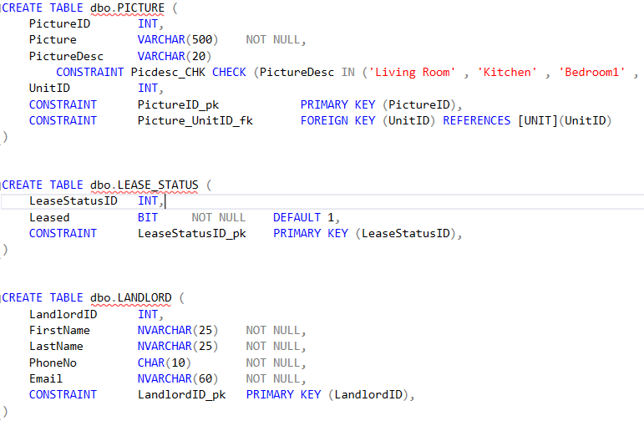
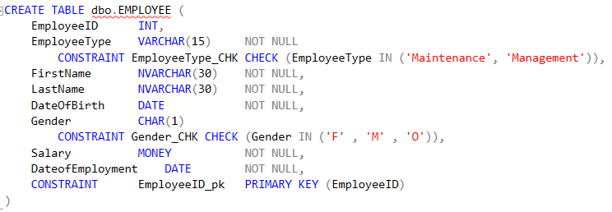

Slide 7
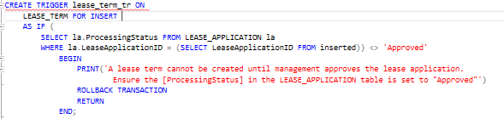
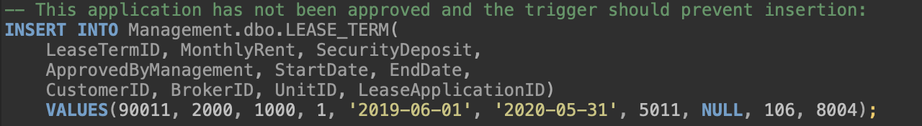
Database Objects (Trigger)
Notes:
Marion

Slide 8
Database Objects( Stored procedures)
Stored procedure to return list of apartments that are available to rent in a given zip code
Stored procedure to get the information of the apartment a customer has rented
Stored procedure to find landlord details for a unit
Stored procedure to calculate average salary with input and output parameters

Slide 9
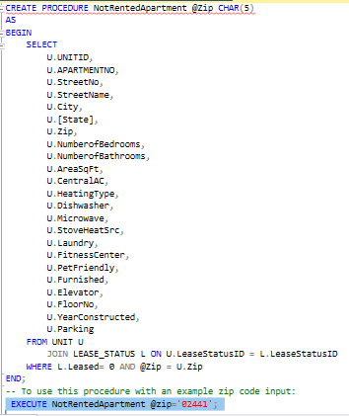
Procedure to return list of apartments that are available to rent in a given zipcode
Notes:
Mansi

Slide 10
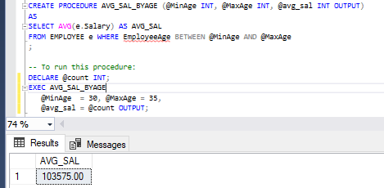
Procedure to calculate average salary with output parameters

Slide 11

Database Objects (Views)
View to combine the key fields that describe a maintenance request and the employee assigned to the request
View to see a list of employee’s skills/certifications
View to combine the customer and broker information related to a specific Unit

Slide 12
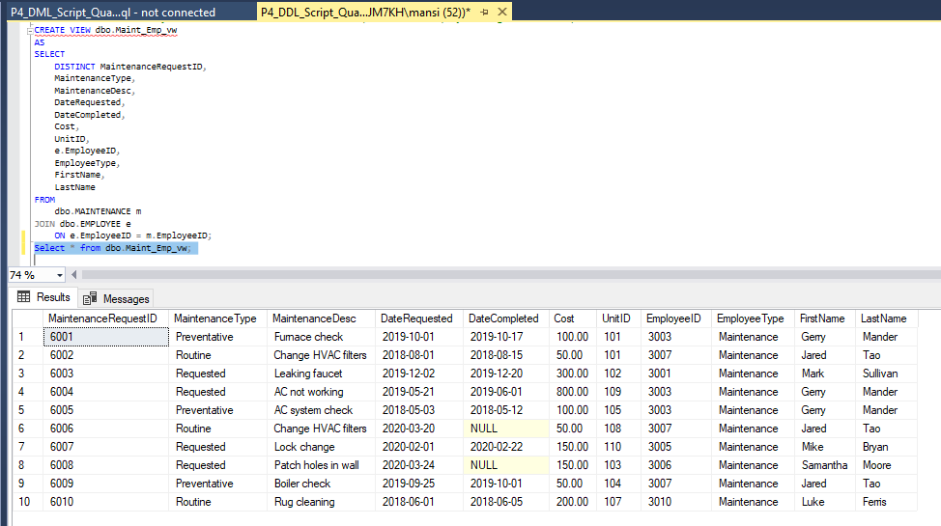
View to combine the key fields that describe a maintenance request and the employee assigned to the request

Slide 13
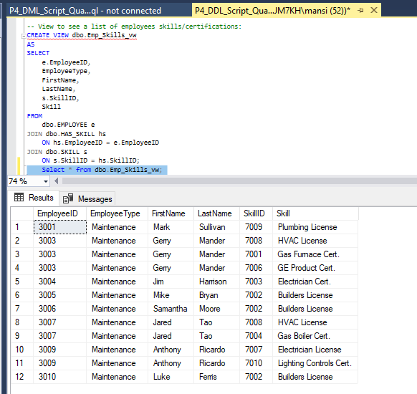
View to see a list of employee’s skills/certifications

Slide 14

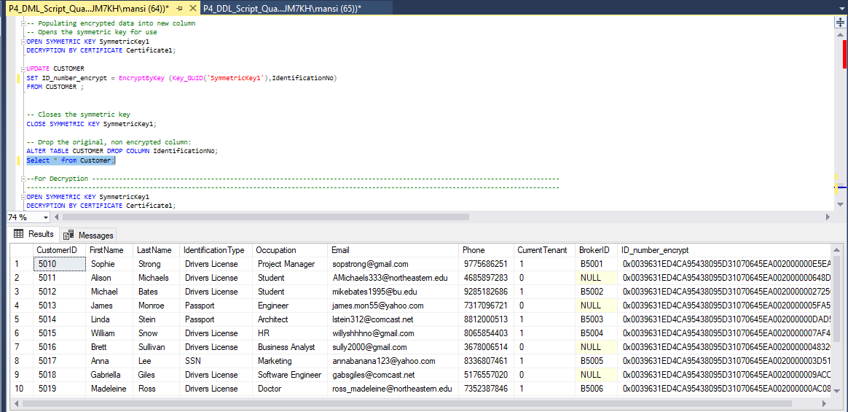
Column Data Encryption

Slide 15
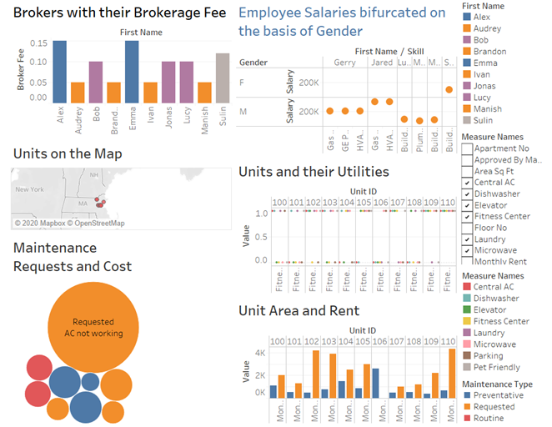
Tableau
Notes:
Varad

Slide 16
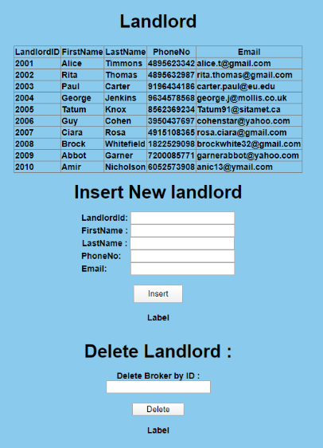
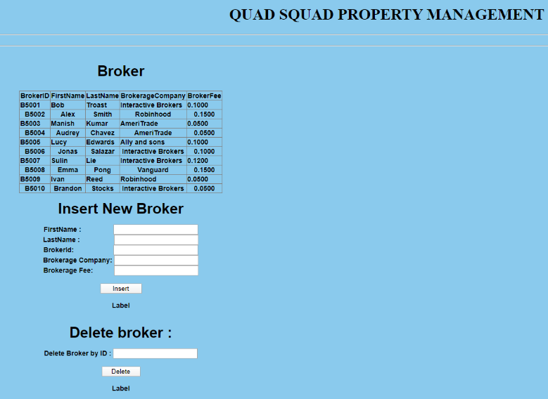
Graphical User Interface
Notes:
Varad

Slide 17
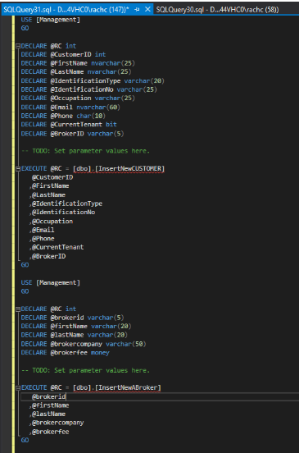
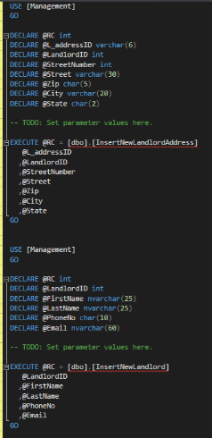
Stored Procedure (GUI)

Slide 18
Thank You

Slide 19
Appendix

Slide 20
DDL Script

Slide 21
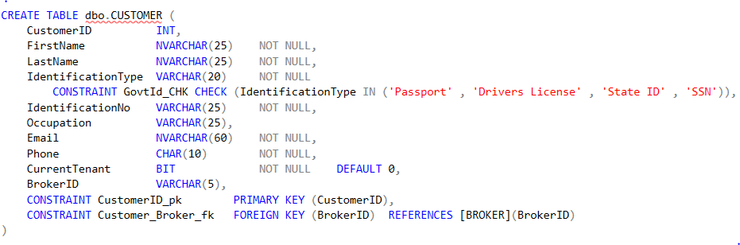
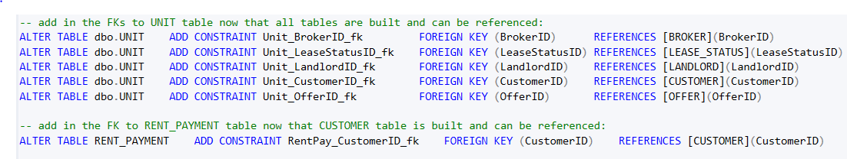

Slide 22
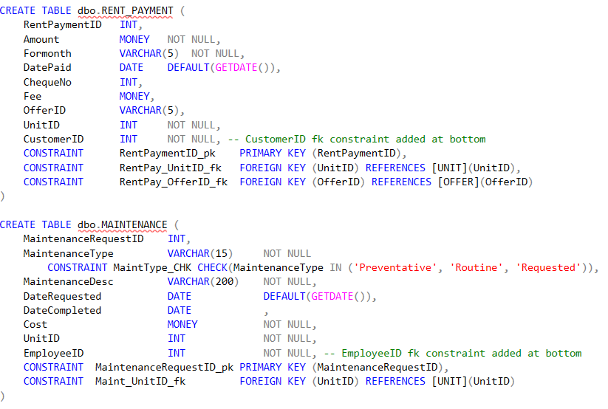

Slide 23
Database Objects (Stored Procedures, Views, Functions, etc..)

Slide 24
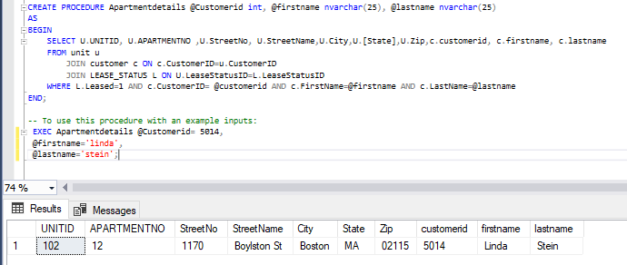
Procedure to get the information of the apartment a customer has rented

Slide 25
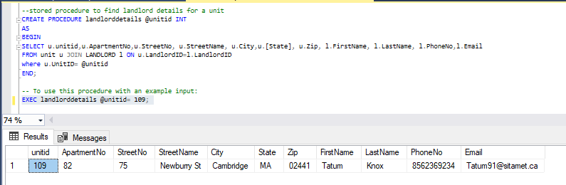
Procedure to find landlord details for a unit

Slide 26
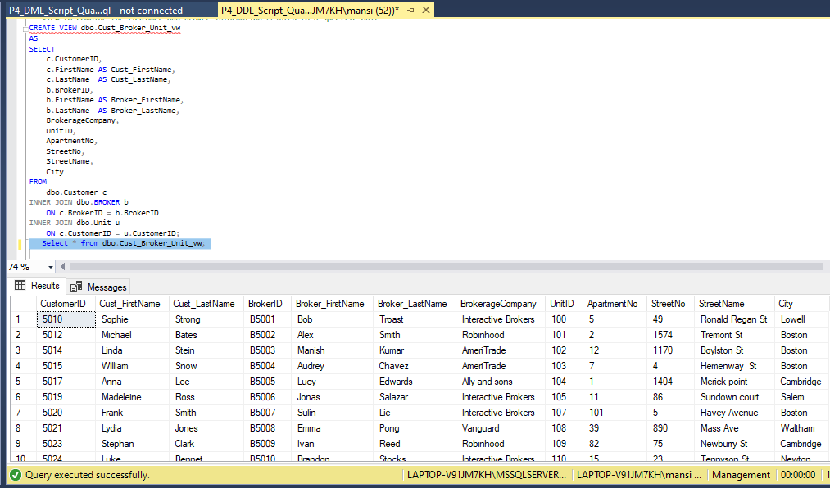
View to combine the customer and broker information related to a specific Unit

Slide 27
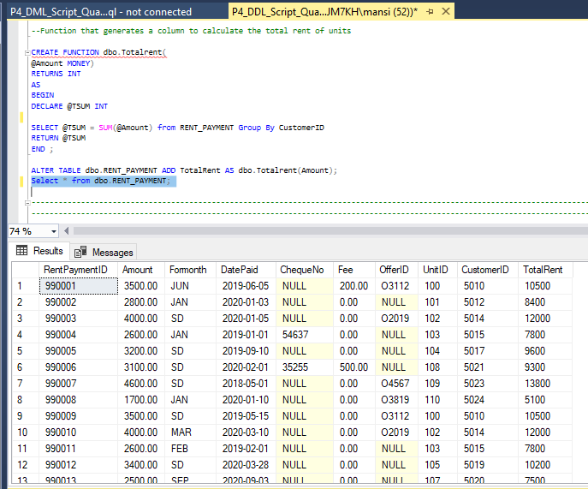
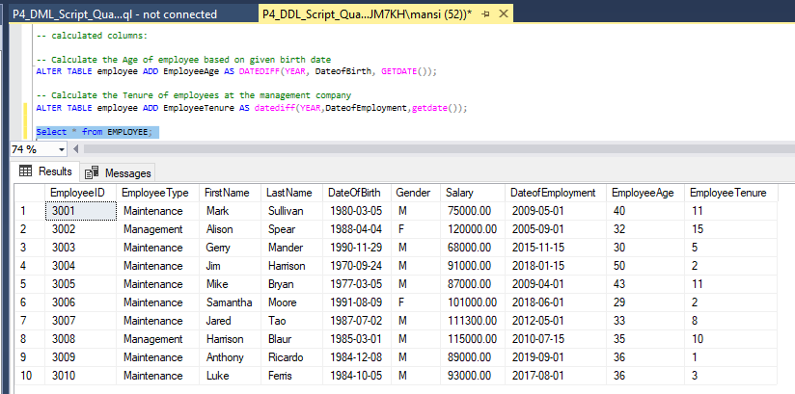
Computed Columns Based on Function

